Slide 1




Slide 1

Slide 2


z
Purpose
Code
Data Preparation
Analysis
Visualization
Challenges
Next?
Conclusion

Slide 3


Slide 4
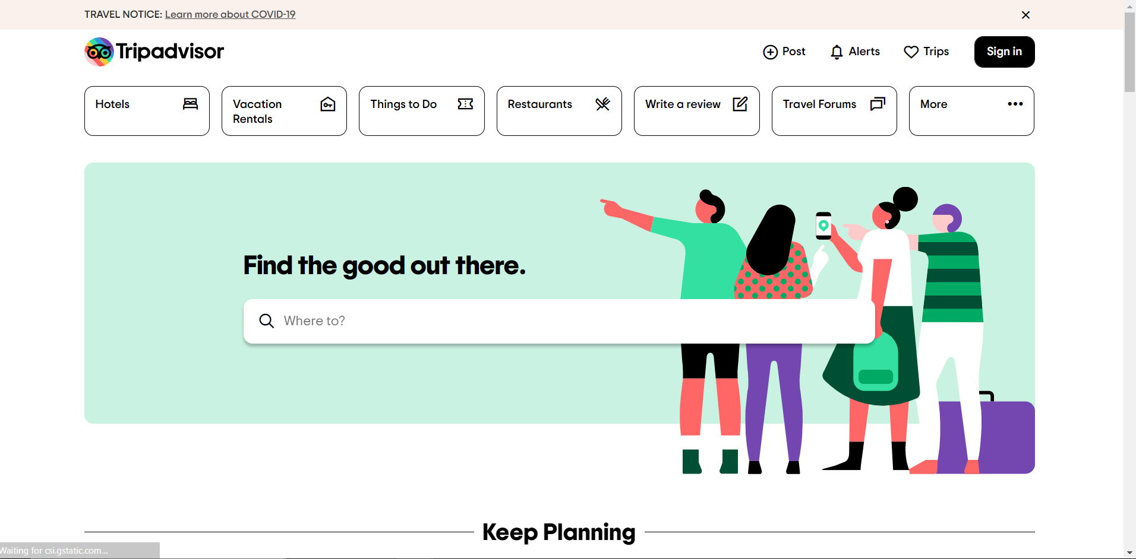

Slide 5
Why Trip advisor
There is a need to search for available activities that can be adapted to local contexts
We all need to go out sometime…

Slide 6
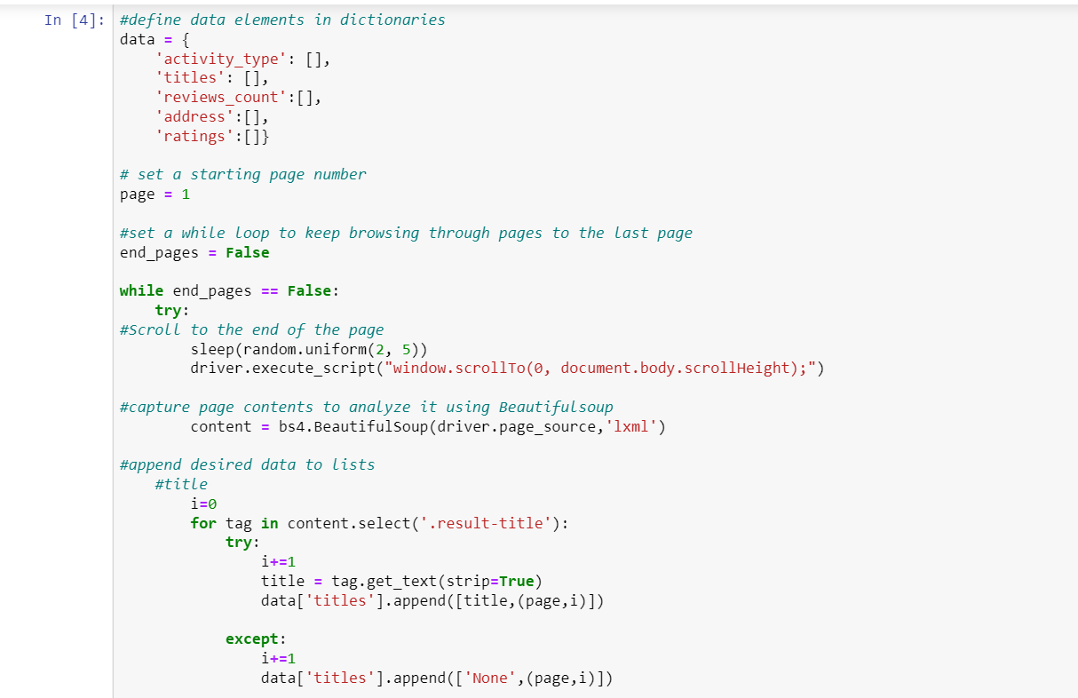

Code

Slide 7
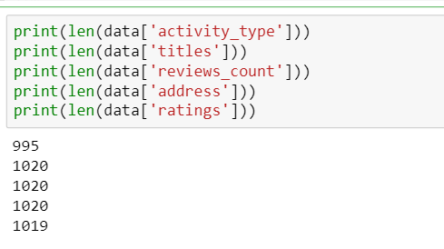
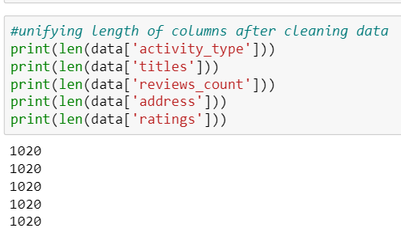

Matching Indexes & Length

Slide 8
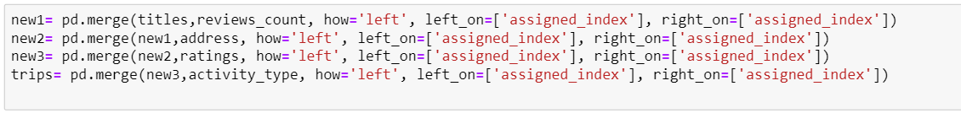
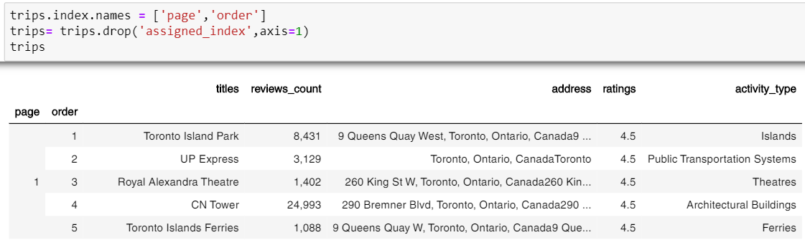
Merging data & Multi-Indexing

Slide 9
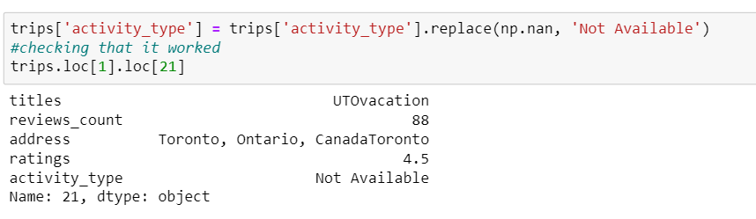
Cleaning Data
Change data type
Replace missing values and garbage data

Slide 10
Analysis
Explore data and find relationships
Visualization

Slide 11
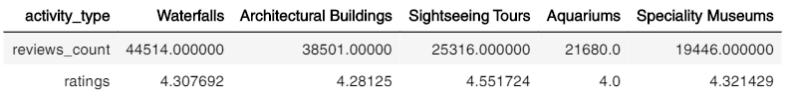
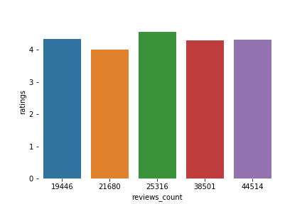
Sightseeing
Museums
Buildings
Waterfalls
Aquariums

Slide 12
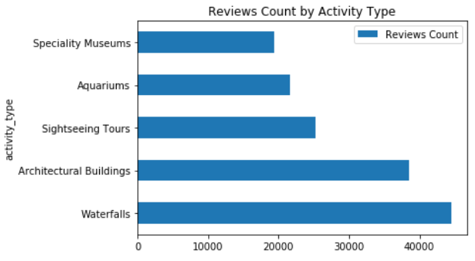

Slide 13
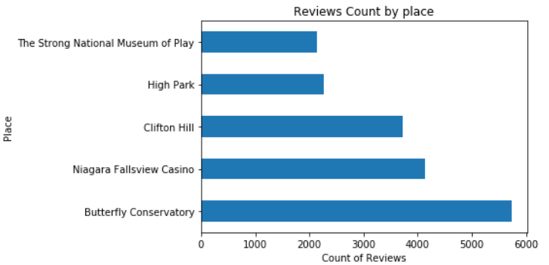

Slide 14
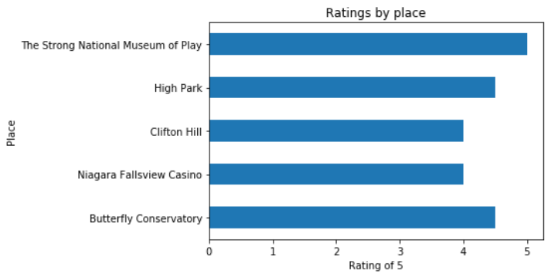

Slide 15
Challenges
Sleep Time Required
Path not found
Data not loaded
Missing Data
Manual work
Data Type
Objective / Time

Slide 16
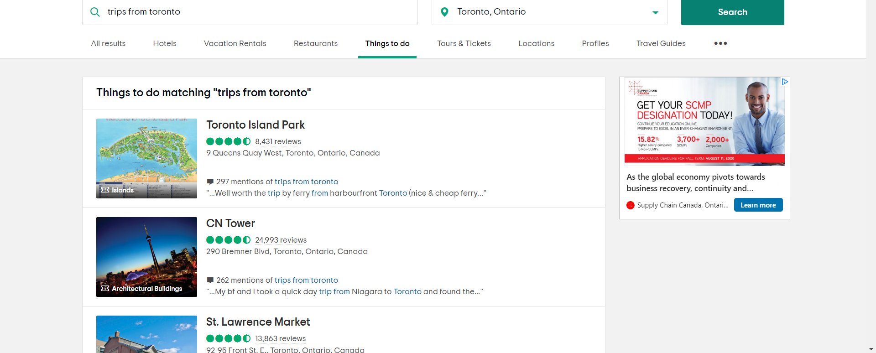
No map option in custom search

Slide 17
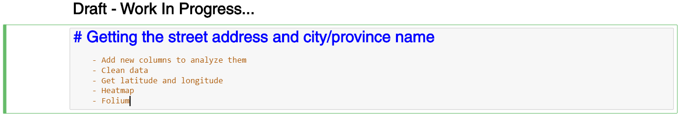

Slide 18
Questions ?

